Slide 1

Enhancing EV Battery Recycling Through Discharge Optimization
Implementing Control Policies to Streamline Battery Discharge and Ensure safe Temperature Levels
Adam Burman
Chalmers University of Technology
2024-04-11

Slide 2
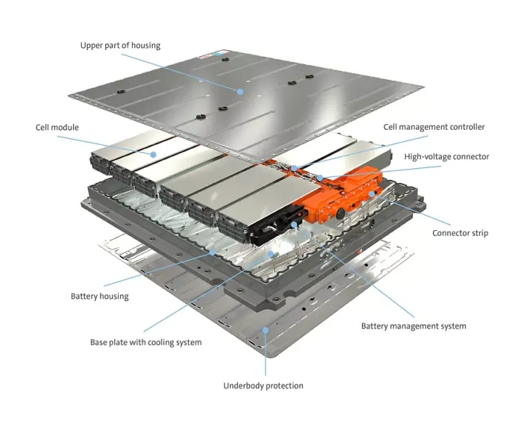
Introduction to the thesis project
LIB – Second life and recycling
Pretreatment
Aim: Reduce discharge time without causing thermal runaway
Notes:
Typically retain 70-80% after EV
Pretreatment usually below 2V
65% increase in demand for LiB from 2021 to 2022 to 550 GWh and as stated in mail 400 GWh sold last year and projection 2030 2000GWh
The current industry involves low discharge rate. Pros safe, cons slow

Slide 3
Project plan
Literature review
Modelling
Cell level control
Module level control
Experiments and Validation
Notes:
Pretreatment, modelling, control

Slide 4

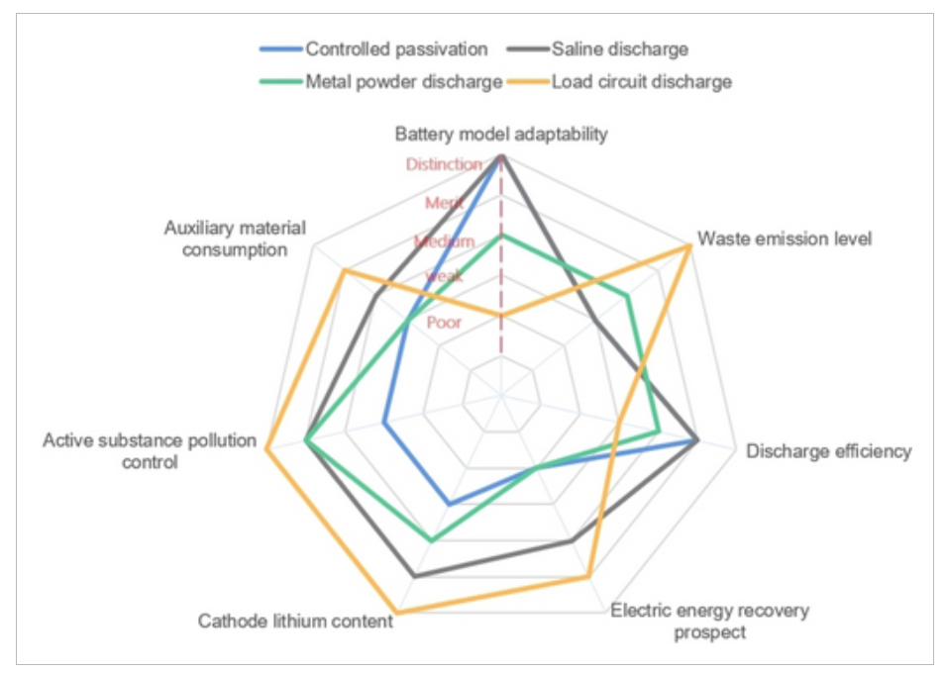
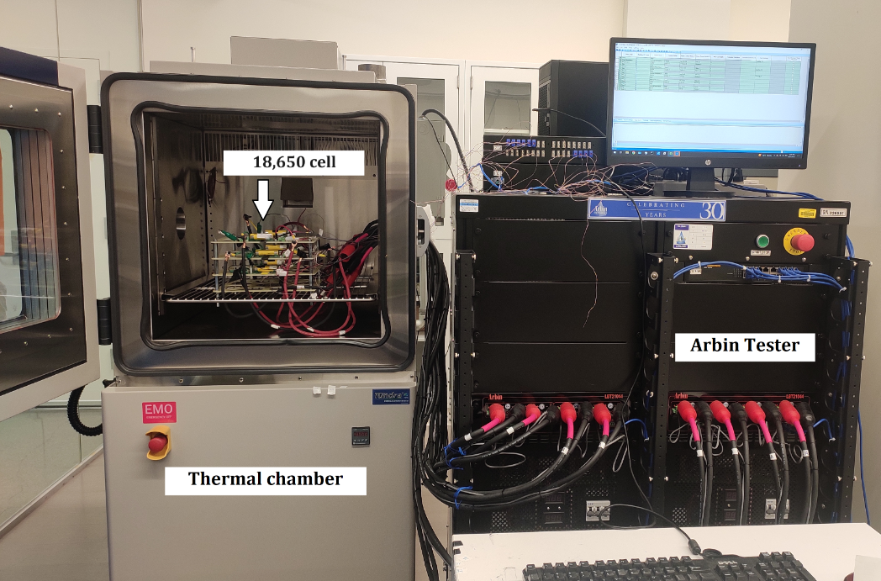
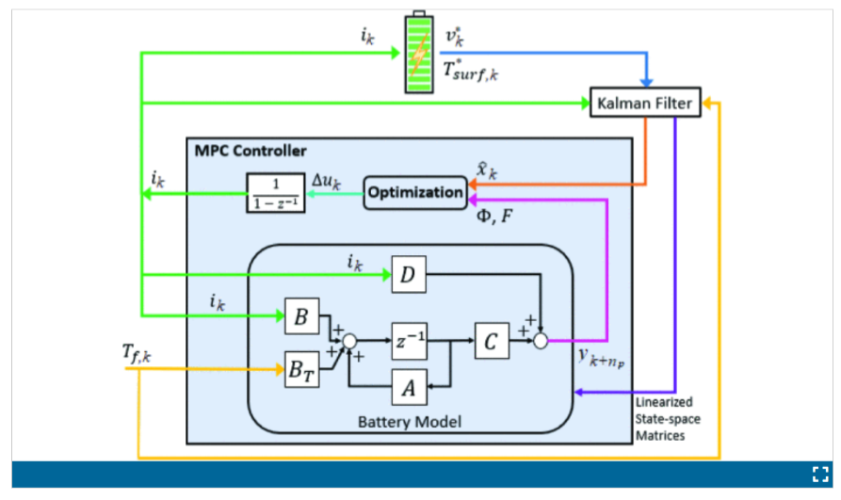
Literature review - Pretreatment
Current Situation and Development Prospects of Discharge
Pretreatment during Recycling of Lithium-ion Batteries: A Review
Minhao Shi, Prof. Yinghui Ren
Pretreatment of Lithium Ion Batteries for Safe Recycling with High-Temperature Discharging Approach
Chris Mi
Different methods, Chris Mi, MPC

Slide 5
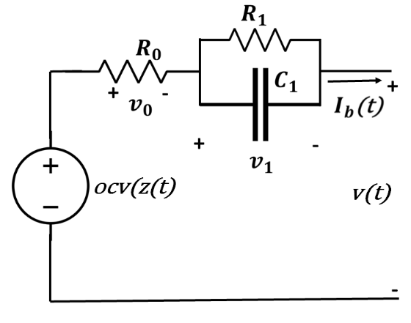
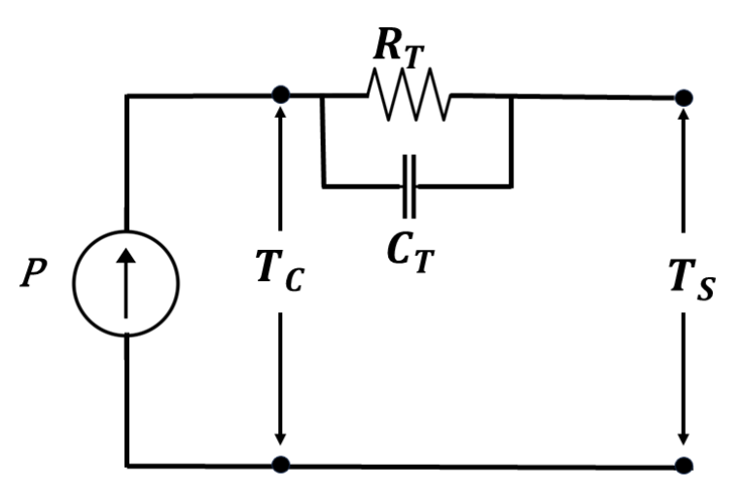
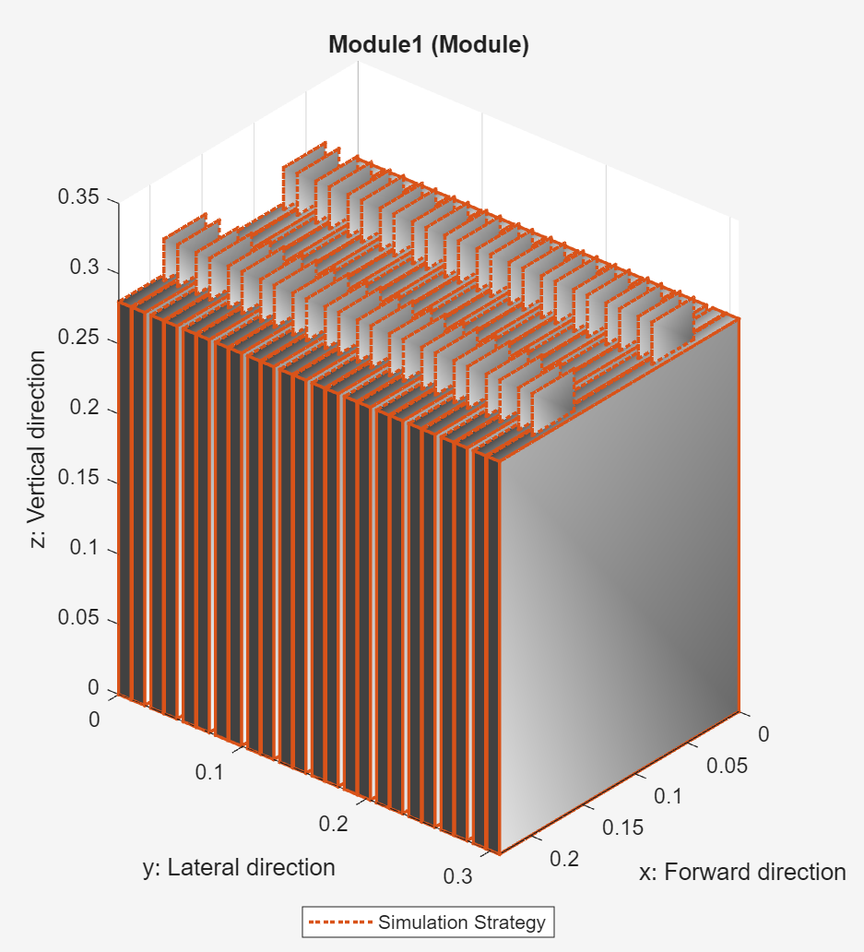
Literature review - Modelling
Cell level
MATLAB
PyBaMM
Module level
Electrical
Thermal
System identification
ECM and self-heating thermal model
Chris Mi
Battery Module model created in MATLAB

Slide 6

Literature Review - Control Strategies
Problem formulation – $\underset{ }{\begin{aligned}\min_{\left\{u_{1:N}\right\}}t_{f} \\ s.t. x\left(k+1\right)=f(x(k),u(k)) \\ {u_\min{ }≤u}_{k}≤u_\max{ } \\ x_{k}∈𝒳\end{aligned}}$
Currently used control – CC/CV
Fuzzy Logic Control
PI
MPC

Slide 7
Experiments and Validation
Chalmers Battery Lab or Stena Recycling Halmstad
Battery models used as parameter estimation and validation
Reiterate models if necessary

Slide 8

Thank you for listening!
Questions?

